Slide 1
Gun Control Under Control
Jason Woo

Slide 2
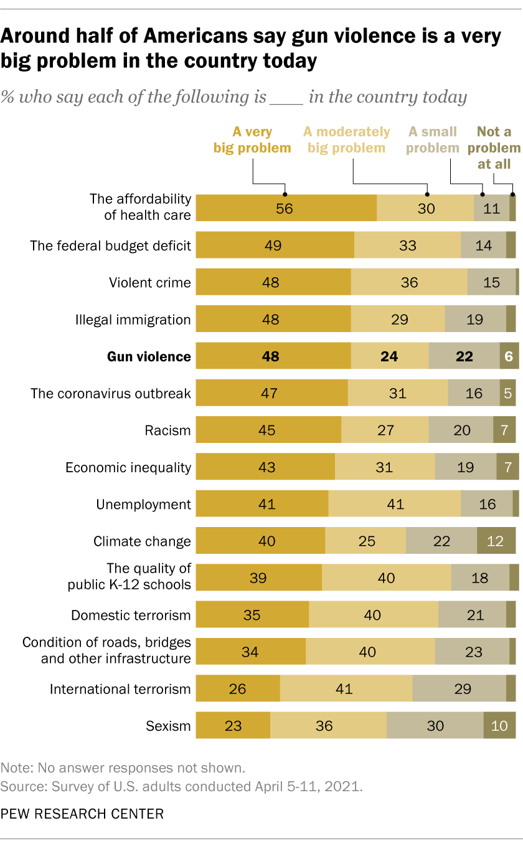
How Americans View Gun Violence
There was a survey conducted by Pew Research Center in 2021 to determine how Americans view gun violence
On a scale of intensities (a very big problem, a moderately big problem, a small problem, and not a problem at all), we see around half (48%) of Americans viewing gun violence as a huge problem

Slide 3
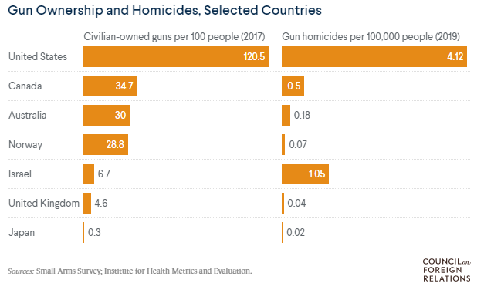
Comparing US to Other Countries
Gun violence is the leading cause of death for young adults and children in the US
Result of the second amendment, anyone has the right to bear arms and shall not be infringed
Other countries however maintain strict gun laws, which we can see from the data on gun ownership related homicides in the bar graph

Slide 4
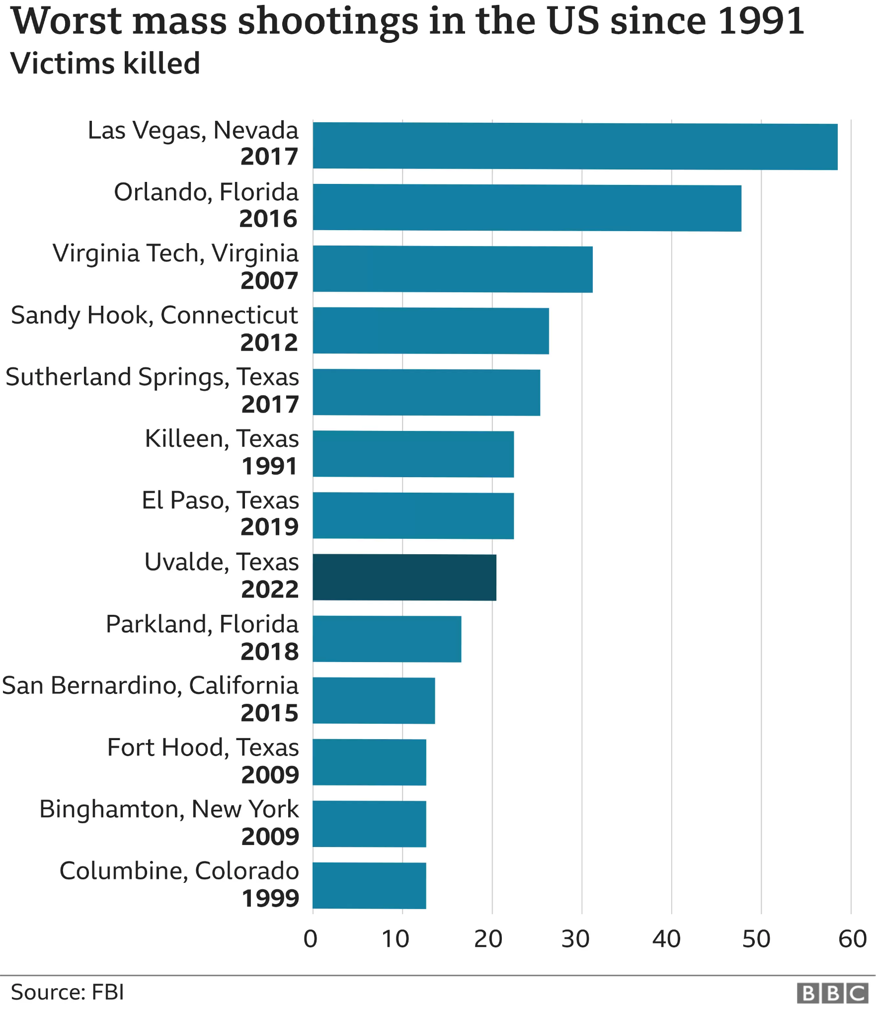
Investigating Mass Murder and Shootings
An investigation found that high - capacity magazines were used in at least 50% of the 62 mass shootings between 1982 and 2012
When high - capacity magazines were used in mass shootings, the death rate rose 63%
Banning high - capacity magazines can also lead to less gun violence, especially mass shootings

Slide 5
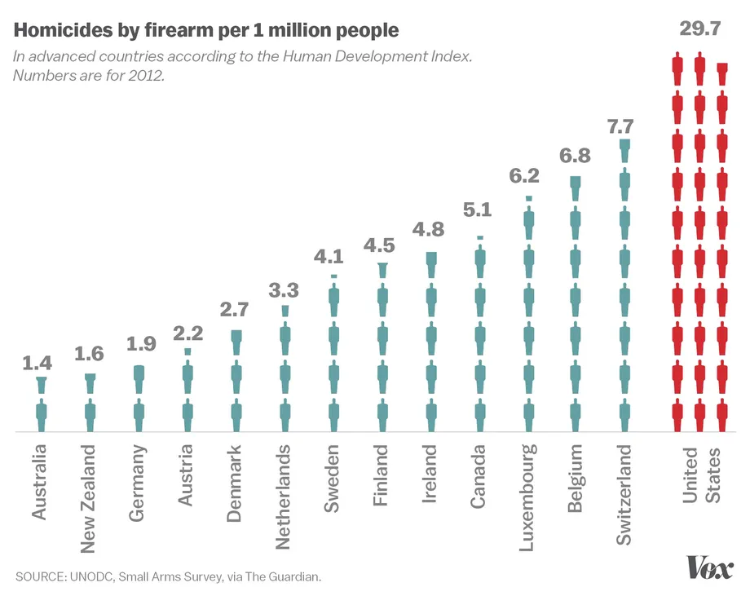
Gun Laws in Other Countries
Gun control was implemented in Australia after the massacre in 1996
Extraordinary acts of violence in UK initiated modern gun control efforts
Gun control was barely an issue in Norway, until an extremist attacked an island summer camp in 2011, and enacted with strict gun laws
Most major countries implement and look into gun control after one instance of tragedy, which the US doesn't seem to be responsible with

Slide 6
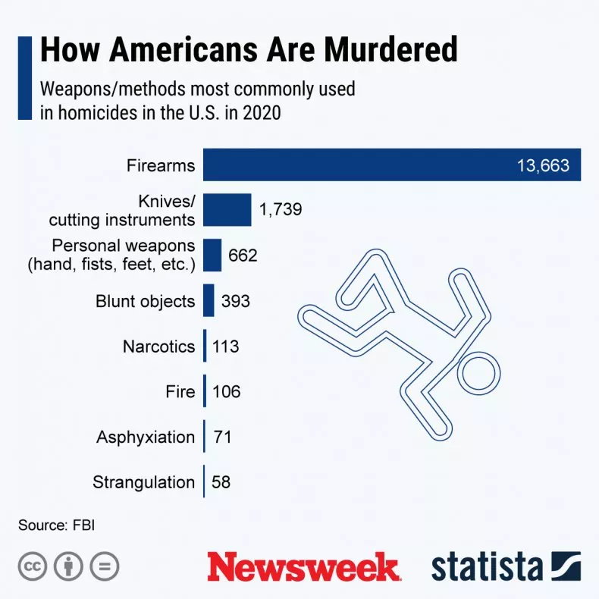
Murder Weapons
This graph from 2020 shows the distribution of weapons of those murdered in the USA
During this particular year, 13,663 of homicides were ones involving a firearm, which is around 700% higher than the next weapon mentioned on the list

Slide 7
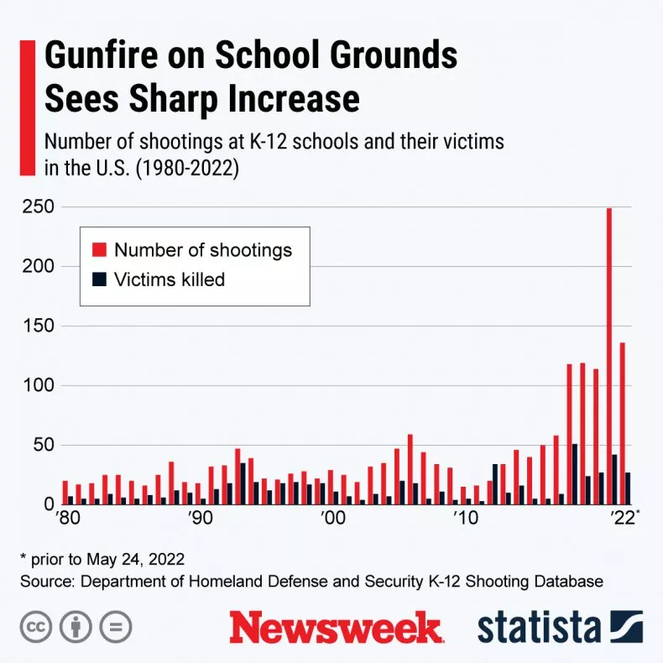
Gun violence on School Grounds
Since 1980, shootings on school grounds from K - 12 has increased and the number of victims killed has increased as well
We have seen a spike since 2015, and is scarily increasing by the year peaking at around 250 shootings in 2021

Slide 8
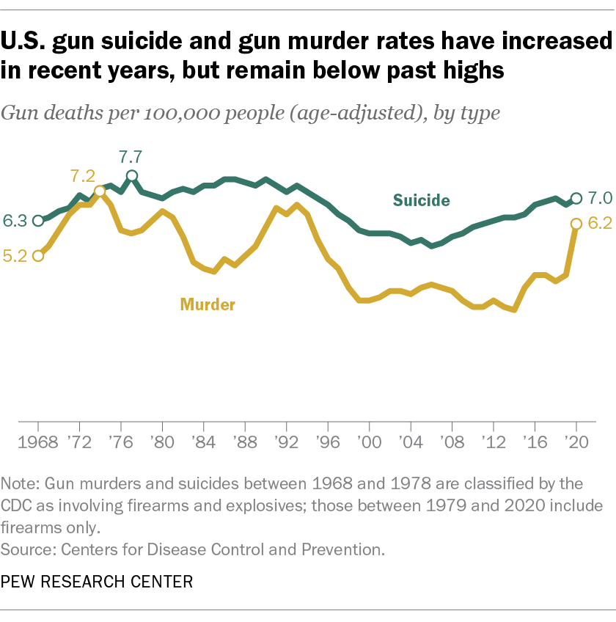
Death rates in US over time
There were 13.6 gun deaths per 100,000 people in 2020, the highest rate since the mid 1990s
There were 6.2 gun murders per 100,000 people in 2020
There were 7.0 gun suicides per 100,00 people in the same year

Slide 9
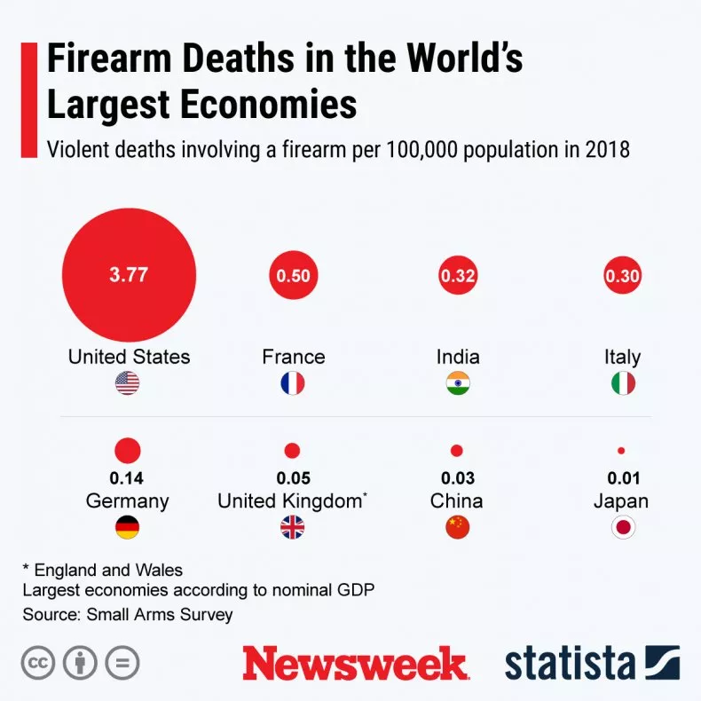
Death rate by country
The US gun death rate was 3.77 per 100,000 people in 2018 compared to other world’s largest economy countries
France is at 0.50 per 100,00, Italy at 0.30 and huge countries like China and Japan under 0.05 per 100,000

Slide 10
Summary
The data can be trusted as most of it were conducted through surveys, or real life data from the news, which is considered a credible source
Cherry - picking may be present since some articles can show bias against the side they are arguing for, but for our standpoint, most articles were fact checked with data and statistics
The news also helped with this considering the news being listed as some of our sources
The sample size is relatively large, whether it was surveying a large group of people or taking into account a whole country of data
Hidden variables are hard to come across since most of what we use is raw data from mainly notable sources

Slide 11
Works Cited
https://www.pewresearch.org/fact-tank/2021/09/13/key-facts-about-americans-and-guns/
https://www.cfr.org/backgrounder/us-gun-policy-global-comparisons
https://gun-control.procon.org/
https://www.bbc.com/news/world-us-canada-41488081
https://www.vox.com/policy-and-politics/2015/12/4/9850572/gun-control-us-japan-switzerland-uk-canada
https://www.pbs.org/newshour/nation/how-do-u-s-gun-laws-compare-to-other-countries
https://www.newsweek.com/us-gun-problem-explain-5-graphs-shootings-1714250

